Slide 1
Effort Estimation using SBSE
Ioana Chelaru

Slide 2
Table of Contents
01
02
03
04
Introduction
The ATLM
Optimized Learning
Conclusions

Slide 3
Software Effort Estimation
Inadequate or overfull funds for a project could cause a considerable waste of resource and time.
For example, NASA canceled its incomplete Check-out Launch Control System project after the initial $200M estimate was exceeded by another $200M [7].

Slide 4
Different approaches
Multiple linear regression
Linear
regression & ANNs
Artificial Neural Networks
with appropriate transformations
[1]
similar performance to MLR, but not always [6]
outperformed MLR
[3]
Artificial Neural Networks & case-based reasoning
Pareto ensemble of ANNs
Analogy-based approaches
best performance compared with a variety of methods
[4]
performed better than MLR
[2]
better results than MLR, ANNs, simple decision trees, and stepwise regression
[5]

Slide 5
The Automatically Transformed Linear Model [8]

Slide 6

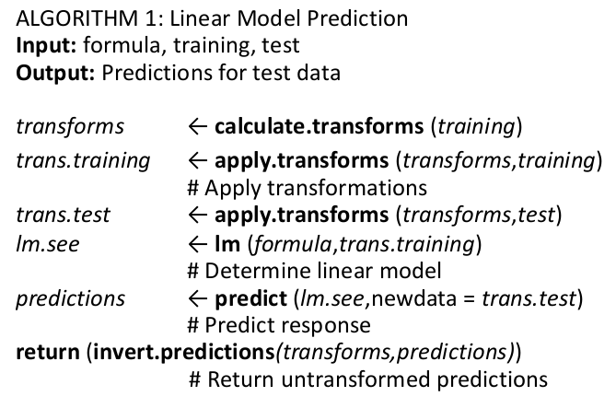
The ATLM

Slide 7
Optimized Learning [9]

Slide 8
Optimized Learning
Python Scikit-Learn
Feature map of data mining options
Utility algorithms
Evolutionary optimizer & automatic mapper facility

Slide 9
Conclusions & future work
SBSE has great potential
the used method depends on the dataset
consider your resources

Slide 10

Bibliography
K. Dejaeger, W. Verbeke, D. Martens, and B. Baesens. 2012. Data mining techniques for software effort estimation: A comparative study. IEEE Trans. Softw. Engin. 38, 375–397.
G. Wittig and G. Finnie. 1997. Estimating software development effort with connectionist models. Inf. Softw. Technol. 39, 469–476.
H. Park and S. Baek. 2008. An empirical validation of a neural network model for software effort estimation. Expert Syst. Appl. 35, 929–936.
L. Minku and X. Yao. 2013. Software effort estimation as a multiobjective learning problem. ACM Trans. Softw. Engin. Methodol. 22, 4.
N.-H. Chiu and S.-J. Huang. 2007. The adjusted analogy-based software effort estimation based on similarity distances. J. Syst. Softw. 80, 628–640.
A. Heiat. 2002. Comparison of artificial neural network and regression models for estimating software development effort. Inf. Softw. Technol. 44, 911–921.
K. Cowing. Nasa to shut down checkout & launch control system, 2002.
Whigham P.A., Owen C.A., and MacDonell S.G. A baseline model for software effort estimation. ACM Transactions on Software Engineering and Methodology 24(3), pp.1-11 (Article 20). doi:10.1145/2738037,2015.
Tianpei Xia, Jianfeng Chen, George Mathew, Xipeng Shen, and Tim Menzies. Why software effort estimation needs sbse. SSBSE’18, 2018
Federica Sarro, Alessio Petrozziello, and Mark Harman. Multi-objective software effort estimation. IEEE/ACM 38th IEEE International Conference on Software Engineering, May 2016.

Slide 11
Thanks!
Do you have any questions?
Please keep this slide for attribution

